Slide 1





Improving Flash Flood Monitoring and Forecasting Capabilities in West Africa with Satellite Observations and Precipitation Forecasts
Humberto Vergara, Vanessa Robledo, Gonzalo Forero
Efthymios Nikolopoulos, Abigail Jones, Ankita Kukrety, Rutgers
Georgios Anagnostopoulos, Akshay Aravamudan, Xi Zhang, FIT
Viviana Maggioni, Malihe Nasibi, GMU
Jonathan J. Gourley, NOAA NSSL
Abdou Ali, AGRHYMET
December 11, 2023

Slide 2
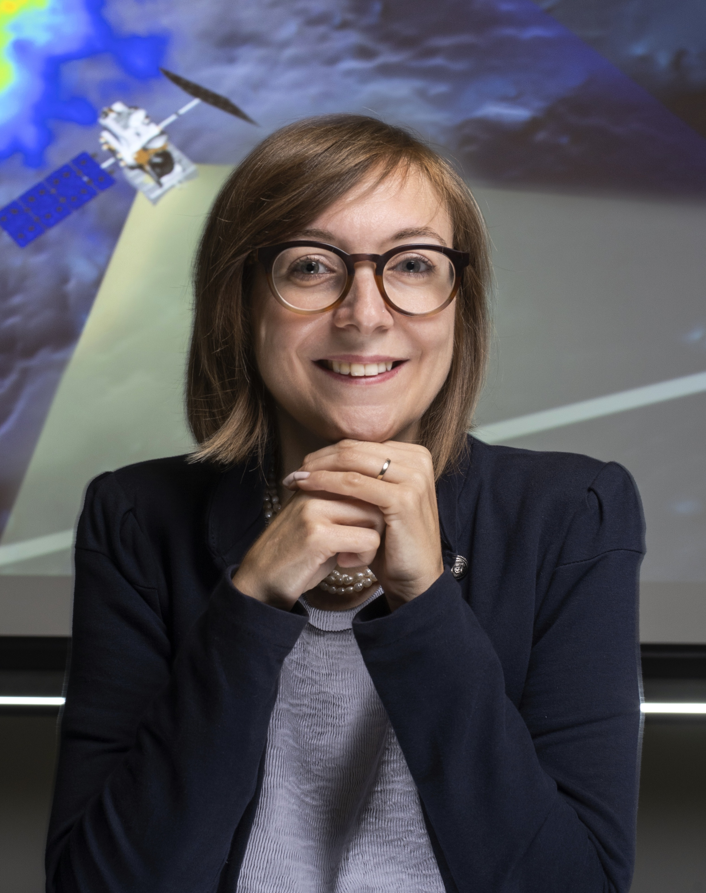

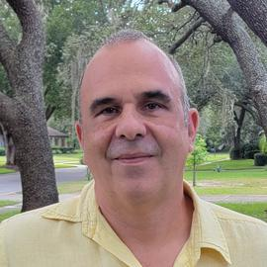
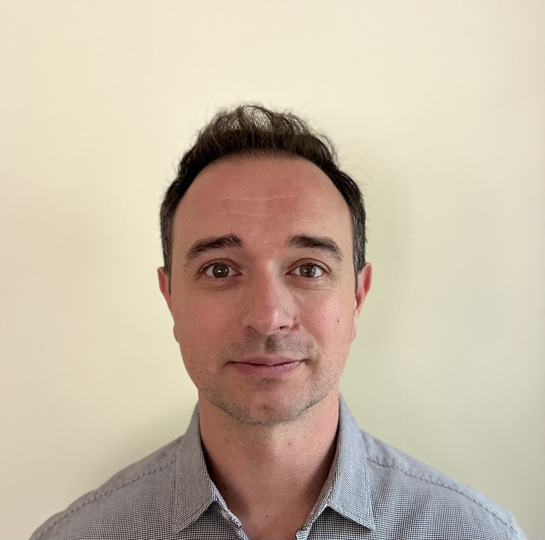
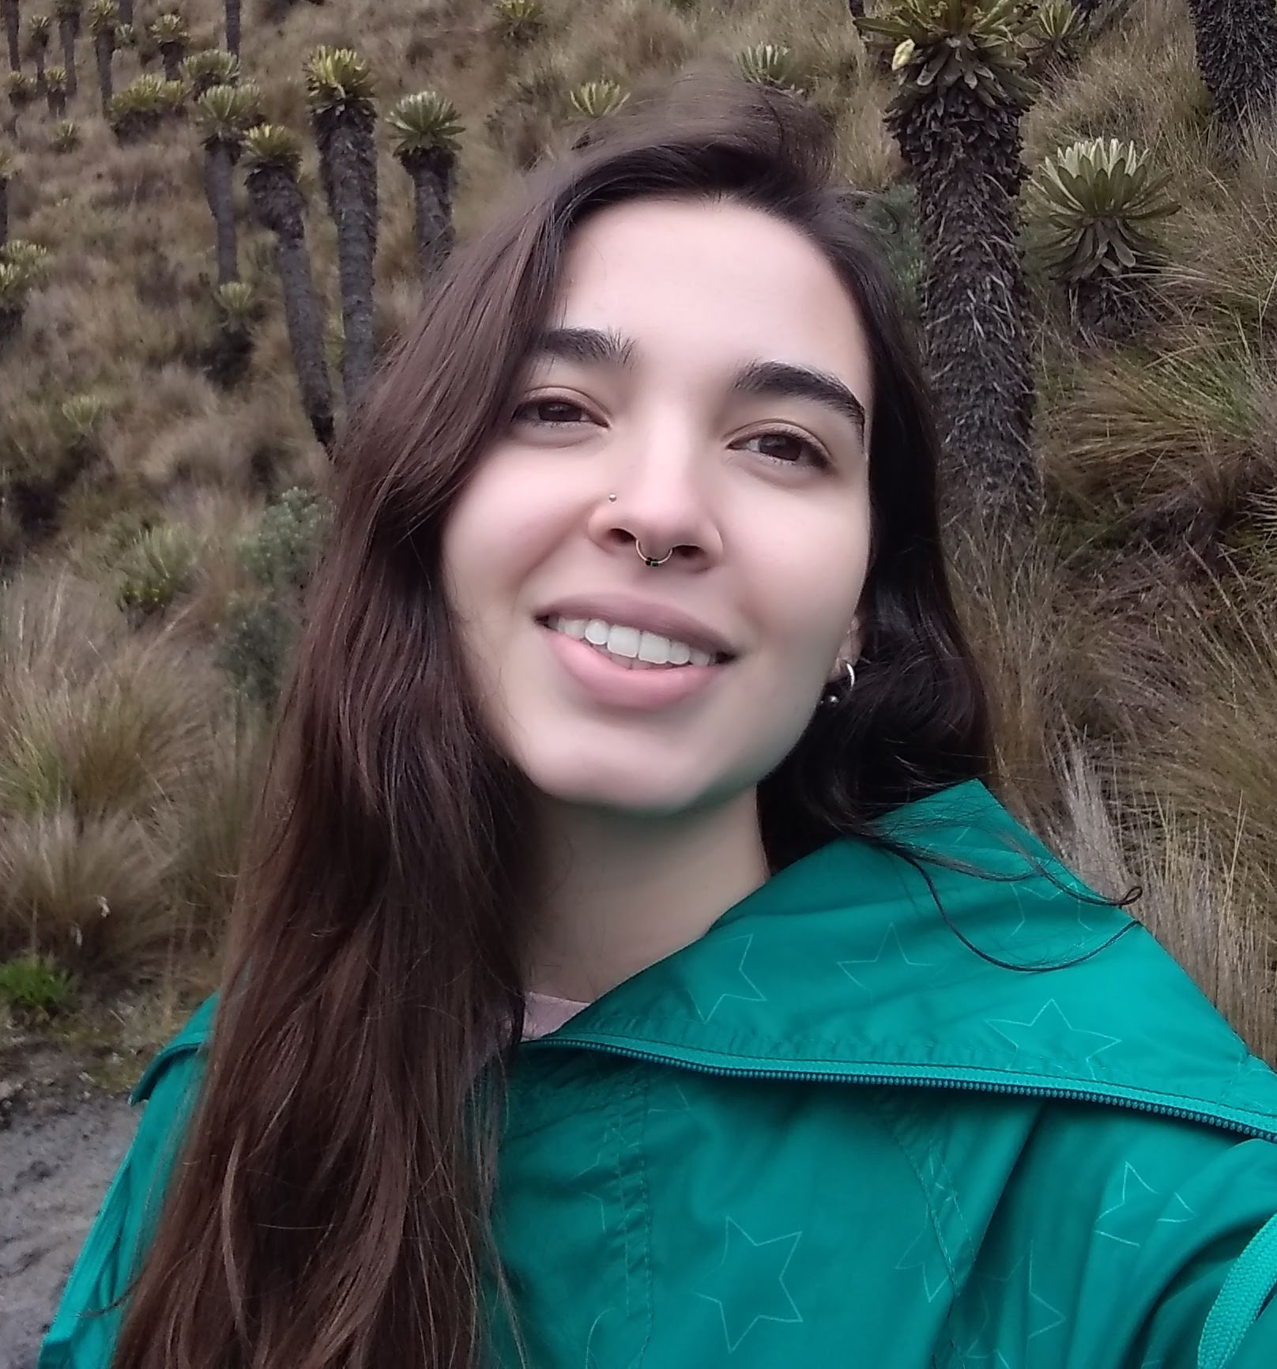

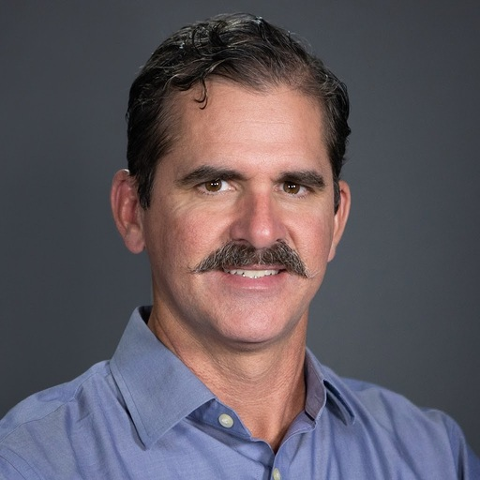
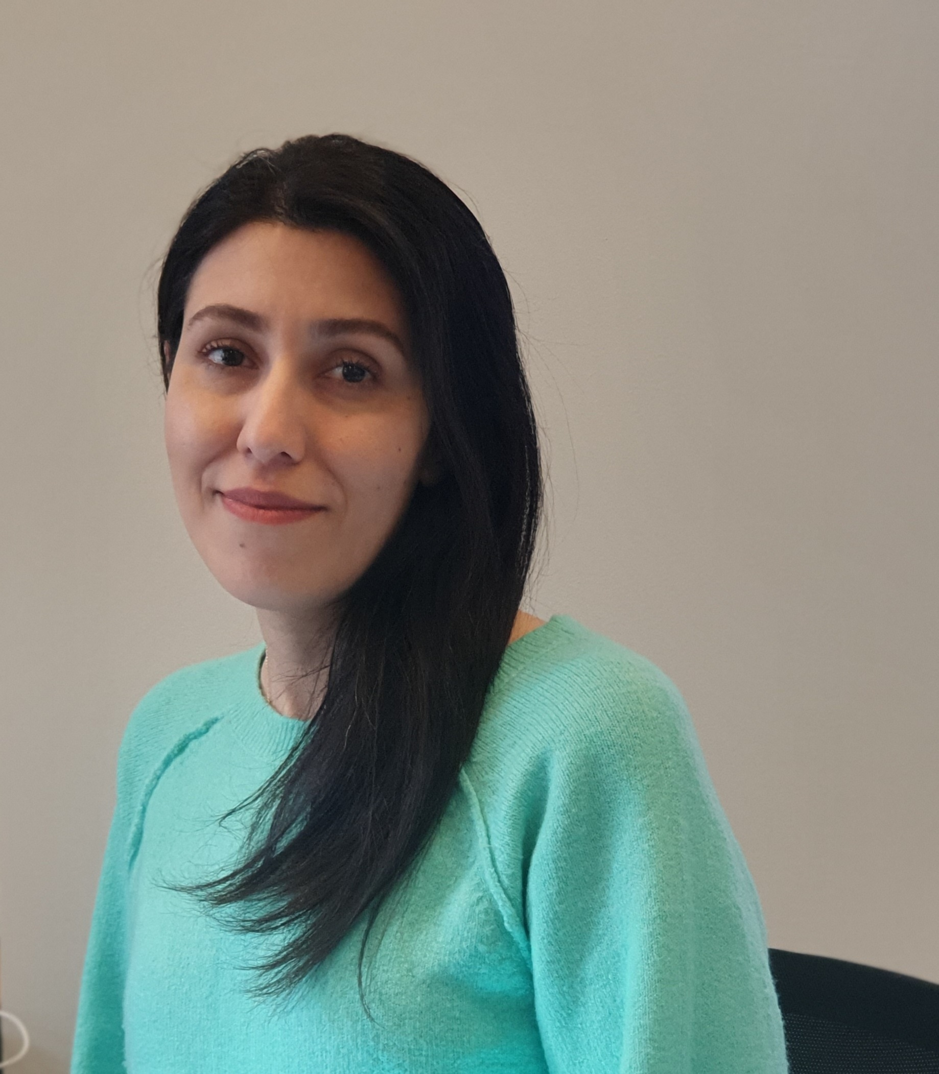
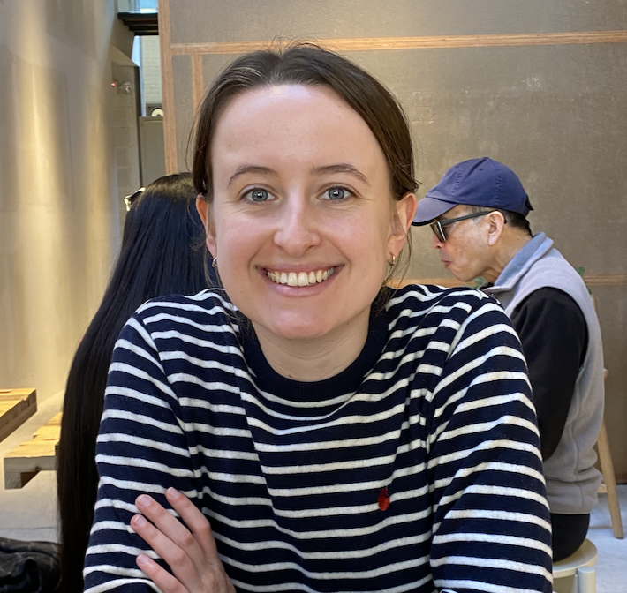

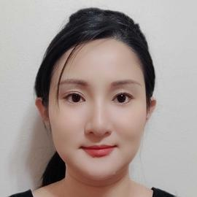


The team
Project: Machine learning based flash flood forecasting in West Africa with satellite observations
Satellite Hydrometeorology
Hydrologic Modeling
Machine Learning
Lead PI
Flash Flood Warning

Slide 3
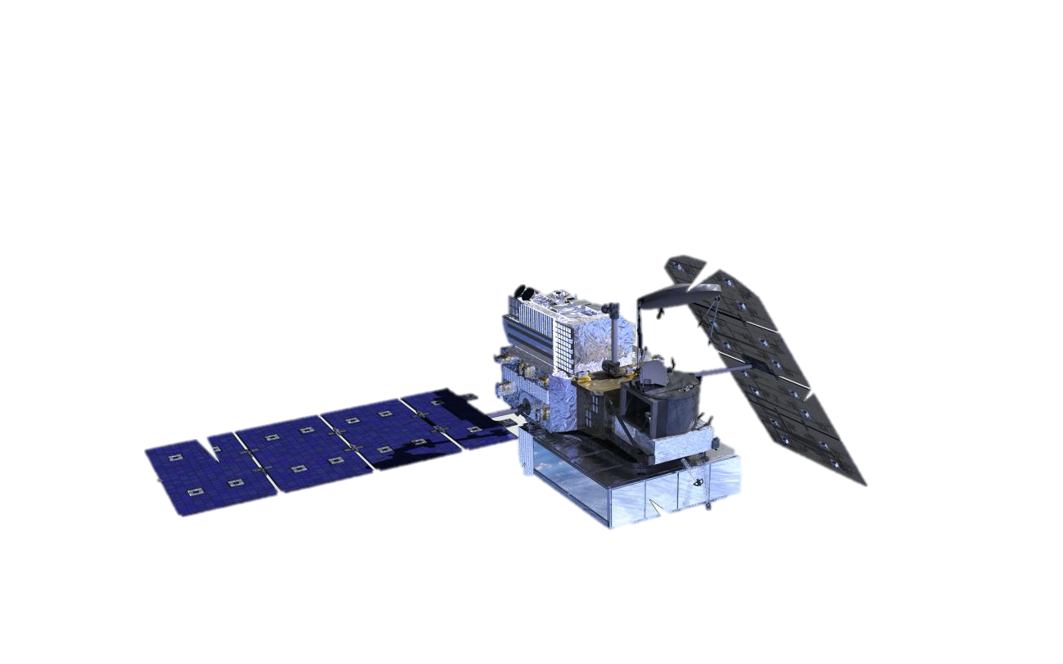
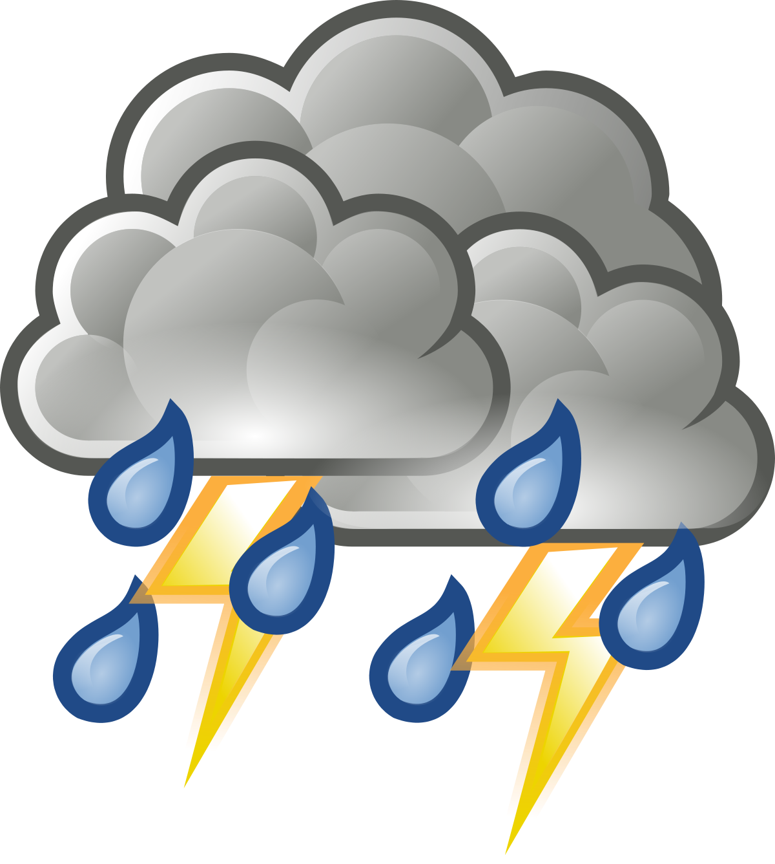

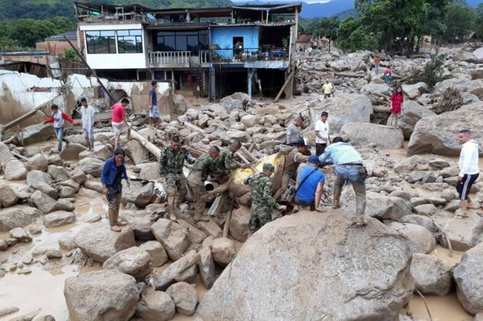
Flash flood warnings require high-resolution/low latency information
Present (Analysis)
IMERG Early: Near-Real Time Capabilities
Rainfall-driven short fused hazard
High rainfall rates
Rapidly evolving/Small spatial scales
~ 4 hours latency
Most recent IMERG
Peak of Event
Monitoring Challenge: Latency
Forecasting Challenge: Predictability
Hydrologic Response
Driving Precipitation
FF Very Likely
FF Likely
IMERG-based 4h Behind
Response from IMERG-based 4h Behind
Desperate search for survivors after flash flood/landslide event in Mocoa, Colombia: 250 fatalities/100s injured Source: (BBC World, 2017)

Slide 4
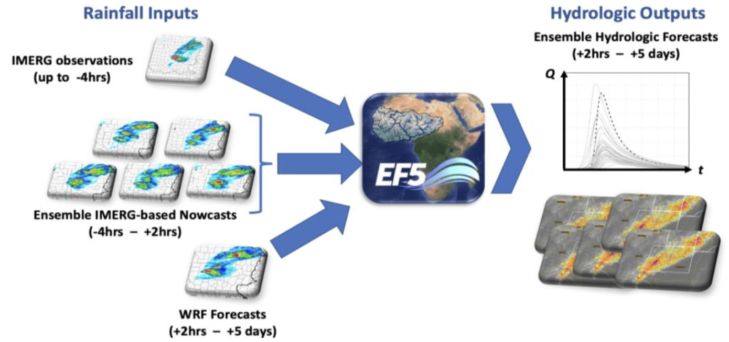
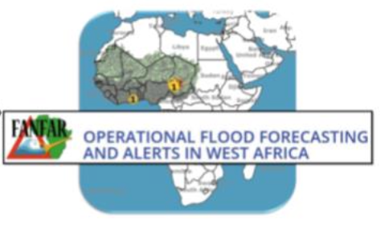

A ML-based Flash Flood Forecasting System for West Africa
Development of a SERVICE for West Africa
Improving capabilities: Integration into existing operational system (WA partners)
Monitoring Challenge: Short-term QPFs based on satellite inputs
Operational Hydrologic Modeling Tool
Forecasting Challenge: Coupling with regional NWP

Slide 5

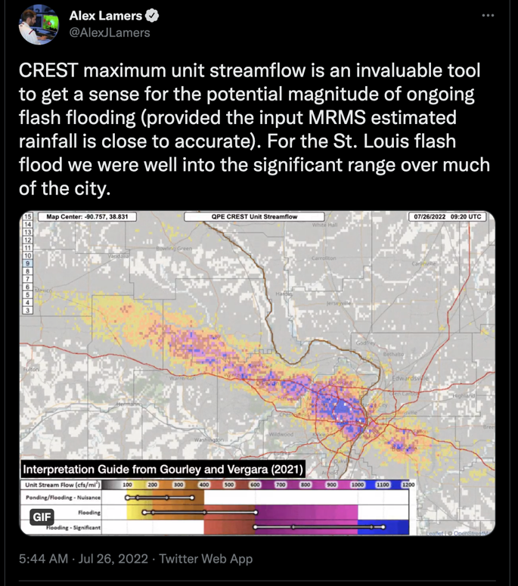


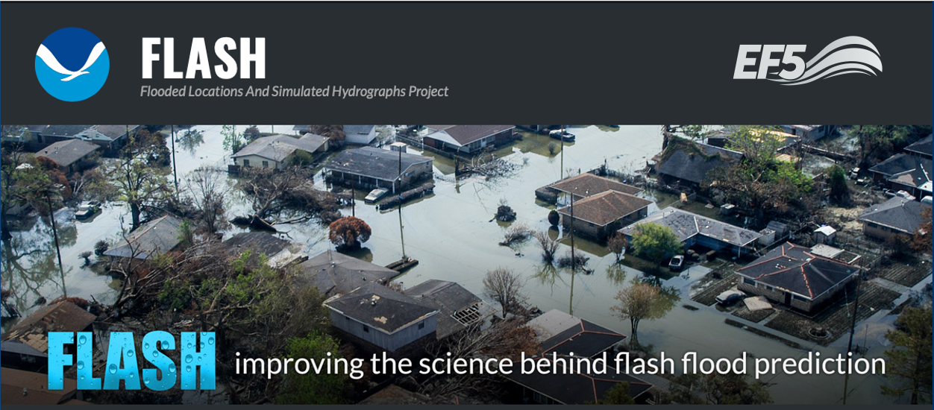




Distributed hydrological modeling for flash flood prediction
EF5 models the macro-processes of the water cycle
PRECIPITATION
EVAPOTRANSPIRATION
RUNOFF
ROUTING
INFILTRATION
Flamig, Z.L., Vergara, H. and Gourley, J.J., 2020. The Ensemble Framework For Flash Flood Forecasting (EF5) v1.2: Description and Case Study. Geoscientific Model Development Discussions, 13, 4943–4958, https://doi.org/10.5194/gmd-13-4943-2020, 2020.
INTERFLOW
ROUTING
STORAGE CHANGE

Slide 6
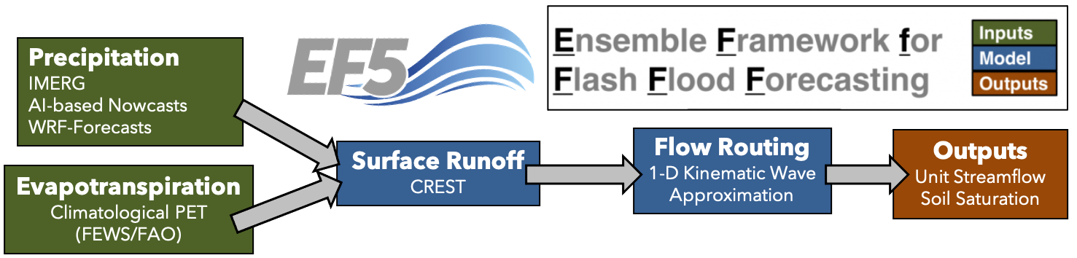
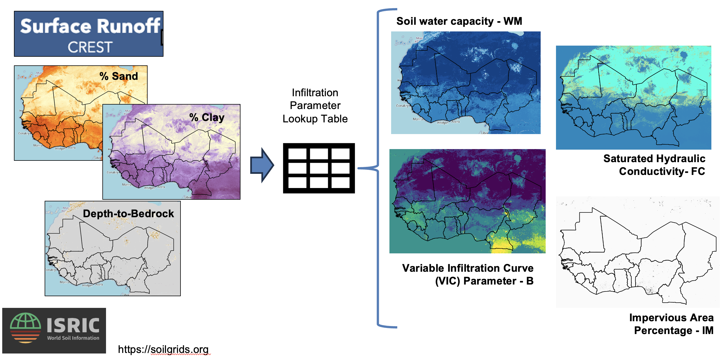
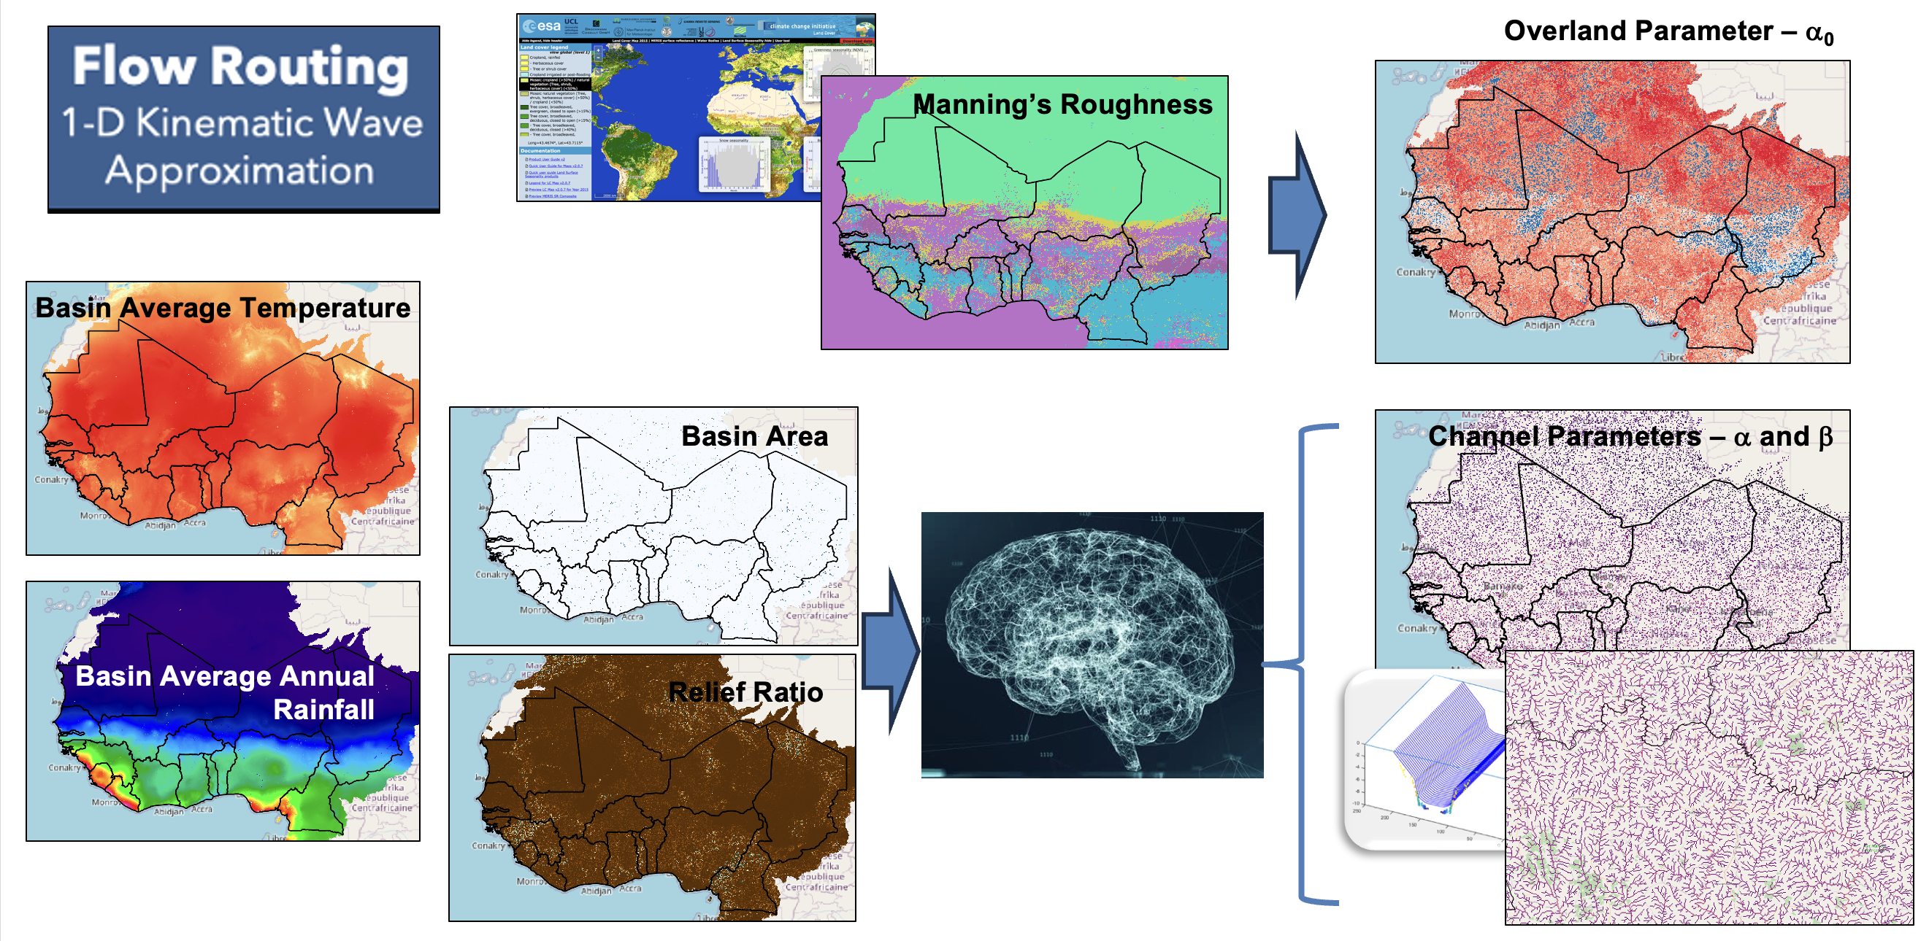
Distributed hydrological modeling for flash flood prediction
a-priori estimates of model parameters based on globally available geophysical data

Slide 7
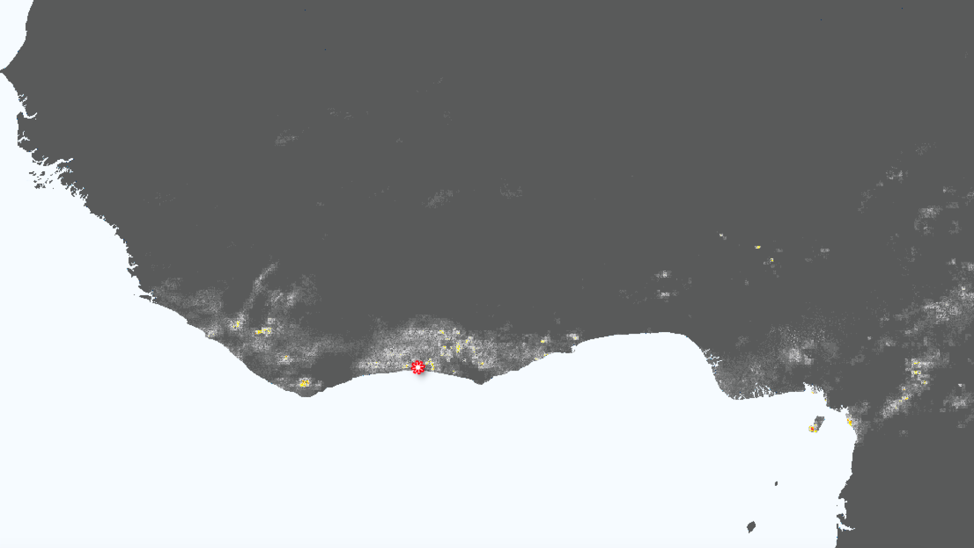
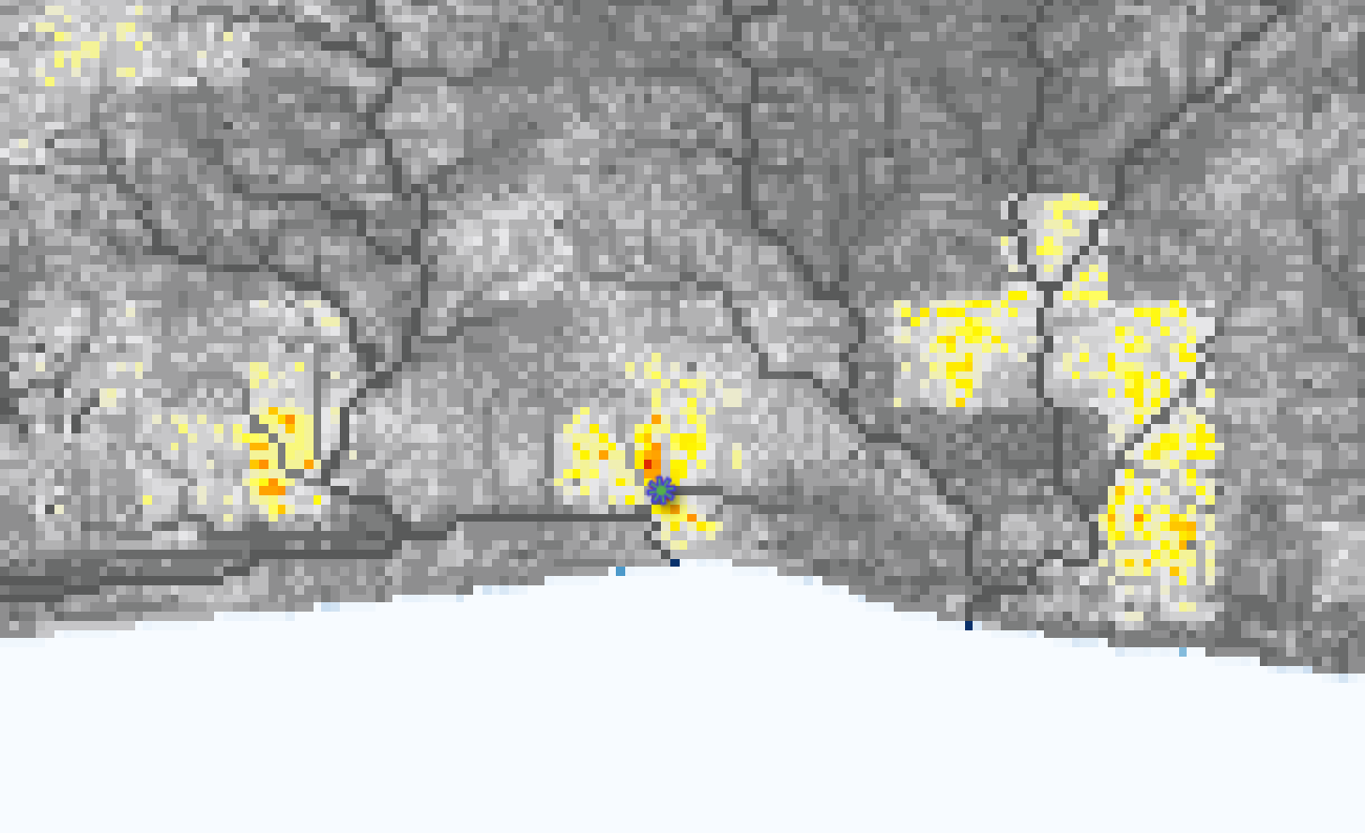
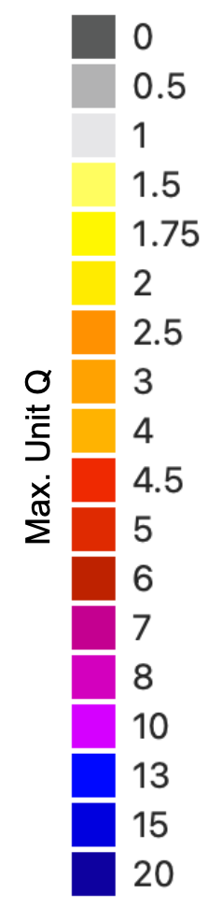
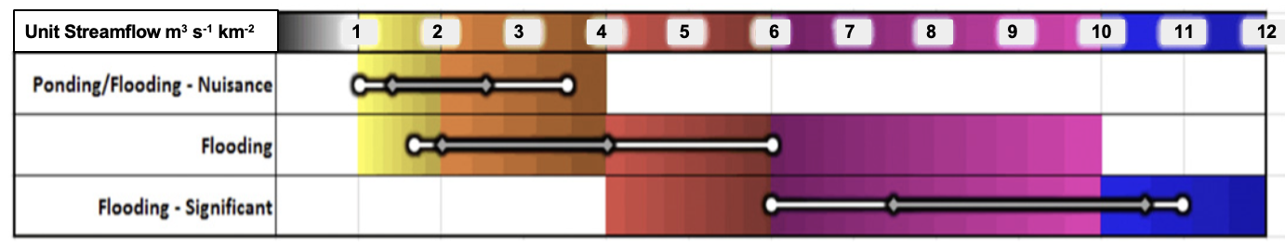
Côte d’Ivoire Flood June 2018: EF5 outputs
Impacts: 18 reported fatalities and severe material damage
Sources reporting this event: Flash Flood Database, Flood List
Unit Streamflow (m³ s⁻¹ km⁻²)
Notes:
EF5 simulation period: 2018-06-18 21:00 - 2018-06-19 21:00

Slide 8
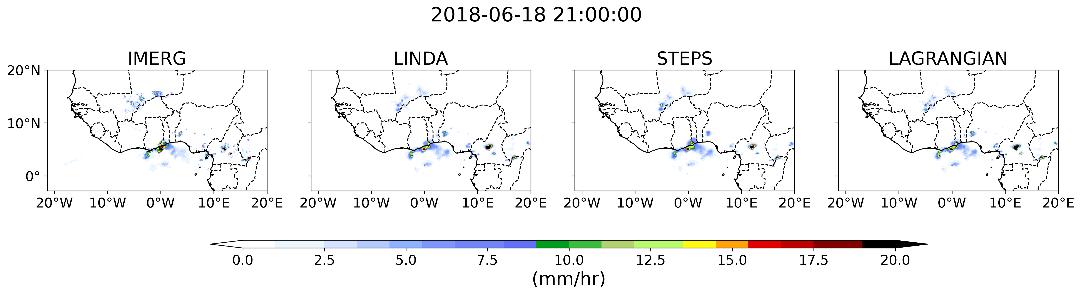
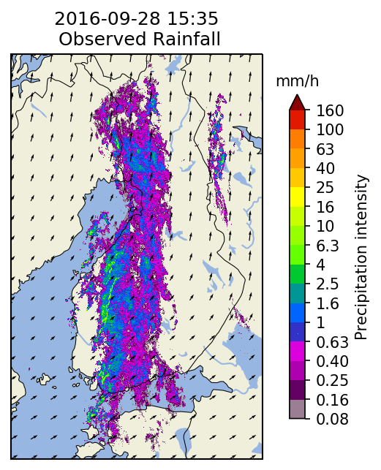
Establishing a robust baseline for short-term QPFs
pySTEPS
https://pysteps.github.io
Pulkkinen, S., D. Nerini, A. Perez Hortal, C. Velasco-Forero, U. Germann, A. Seed, and L. Foresti, 2019: Pysteps: an open-source Python library for probabilistic precipitation nowcasting (v1.0). Geosci. Model Dev., 12 (10), 4185–4219. doi:10.5194/gmd-12-4185-2019.

Slide 9
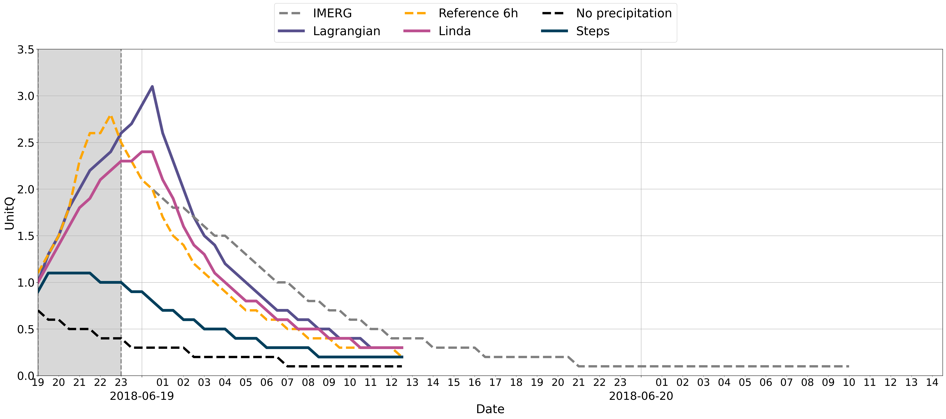
Establishing a robust baseline for short-term QPFs
‘Perfect’
Forecast
Lagrangian
Drainage Area = ~ 2 km²
Linda
IMERG-based Simulation
FF Very Likely
Steps
IMERG with latency
FF Likely

Slide 10

Establishing a robust baseline for short-term QPFs
Drainage Area = ~ 2 km²
FF Very Likely
FF Likely

Slide 11
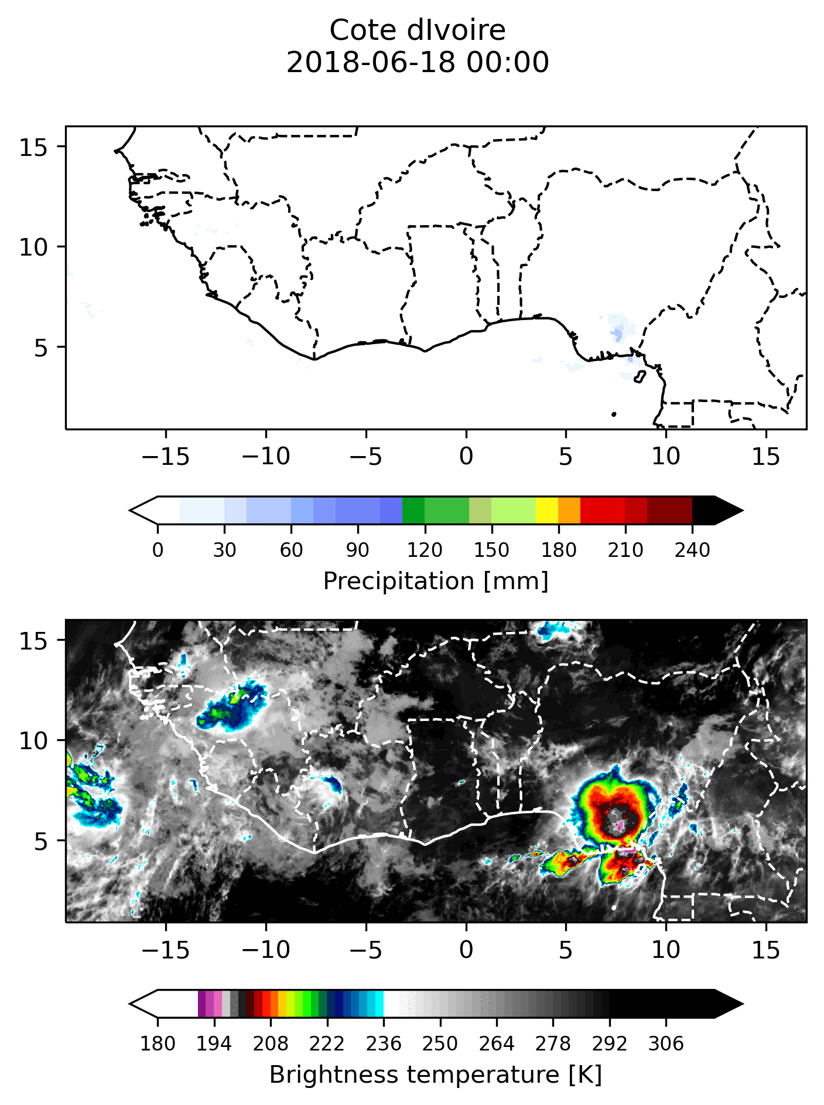
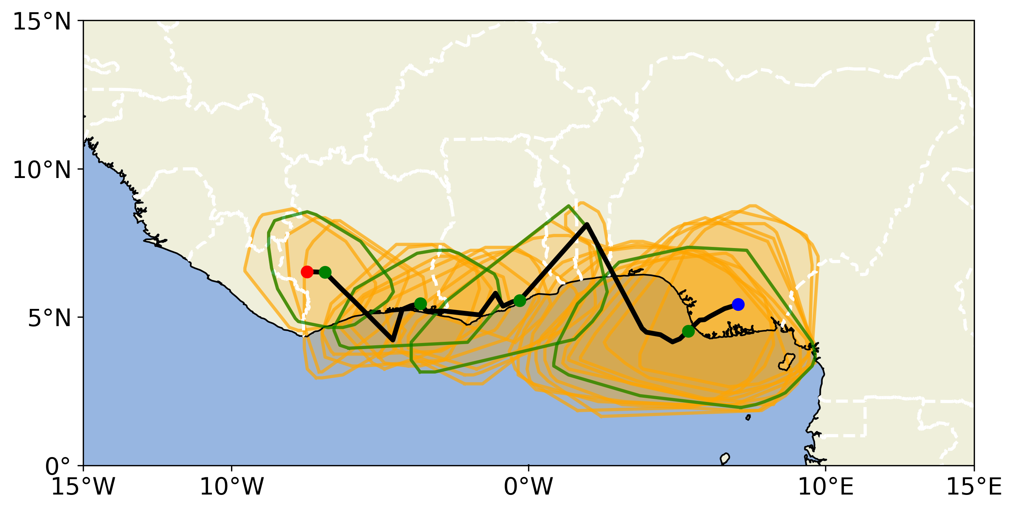

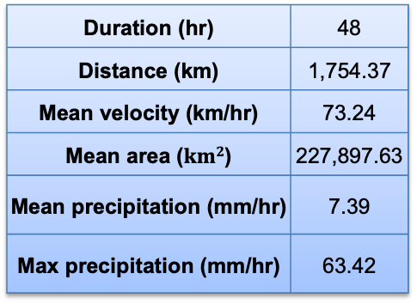
Understanding flash flood predictability in WA
Studying rain storms events in the West Africa domain
Duration (hr) | 48
Distance (km) | 1,754.37
Mean velocity (km/hr) | 73.24
Mean area ($km2$) | 227,897.63
Mean precipitation (mm/hr) | 7.39
Max precipitation (mm/hr) | 63.42
Max. Precip. rates on current track
Individual storm objects
Estimated track from centroids
Ramírez-Cardona, A., Robledo, V., Rendón, A., Henao, J. J., Hernandez, K. S., Rios, S. G., Mejia, J. F. (2022). Algorithm for Tracking Convective Systems (ATRACKCS) (v.1.0), Zenodo, 10.5281/zenodo.7025989
https://github.com/alramirezca/ATRACKCS

Slide 12
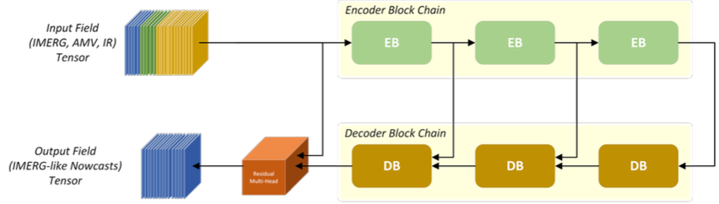
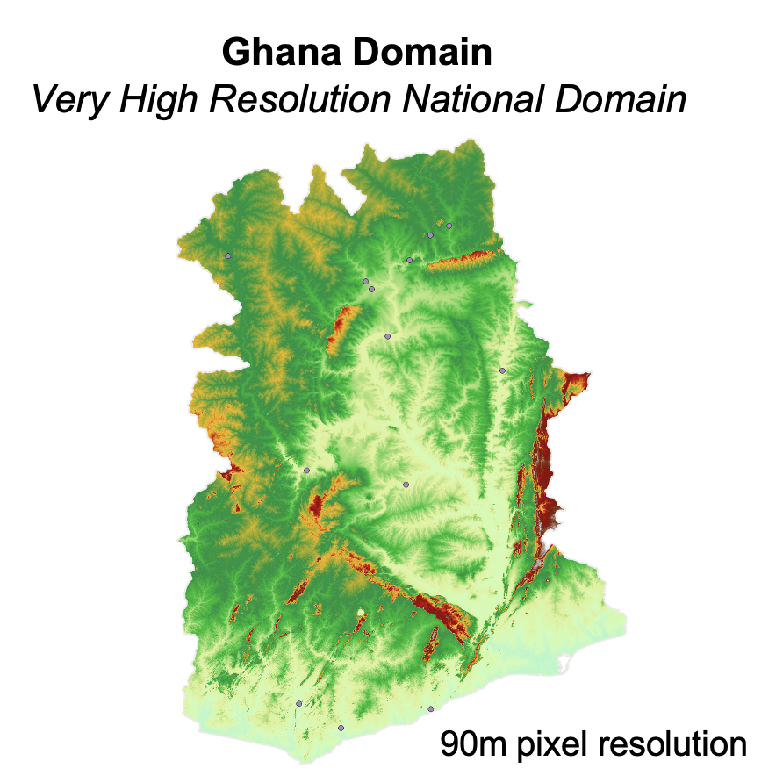

Summary and ongoing efforts
We seek to realize the potential of satellite-based systems to provide timely flash flood warnings
ML-based nowcasting and very high resolution domain in Ghana
Capacity building for West Africa partners
Contact
Humberto Vergara – humberto-vergaraarrieta@uiowa.edu
Lab Website – https://ahwa.lab.uiowa.edu
SERVIR Project (Website coming soon!)
Efthymios Nikolopoulos - efthymios.nikolopoulos@rutgers.edu

